Slide 1
Lung Disease Classification
Fatmeh Shaal - g00090011
MHD Maen Khaskieh - b00085766

Slide 2
Introduction
Problem Area
Lung Disease Detection
Challenge
- Diverse Lung Diseases
- High Variability
Importance
Early Diagnosis for Better Treatment Outcomes
Objective
comparing multiple deep learning models to identify lung diseases

Slide 3
Problem Statement
Challenges
Overlapping Visual features among different diseases
High Variability in chest X-ray images
Proposed Solution
Addressing this challenge by comparing multiple deep learning models
Identifying lung diseases like pneumonia, COVID-19, and tuberculosis

Slide 4
Literature Review
Explainable Lung Disease Classification from Chest X-Ray Images Utilizing Deep Learning and XAI [1]
Deep Learning in Multi-Class Lung Diseases' Classification on Chest X-ray Images[2]
Detection and Classification of Lung Diseases Using Deep Learning[3]

Slide 5
Literature Review
Title | Methodology | Results
Explainable Lung Disease Classification from Chest X-Ray Images Utilizing Deep Learning and XAI [1] | - Seven models were used (Xception, Inception-V3, VGG19, EfficientNetB7, DenseNet201, DenseNet121, ResNet50) XAI techniques such as LIME and Grad-CAM were used to explain model predictions. | Xception achieved 93% accuracy, while DenseNet121 and Inception-V3 reached 92%.
Deep Learning in Multi-Class Lung Diseases' Classification on Chest X-ray Images | EfficientNet v2-M used for feature extraction and classification. - Direct input of raw chest X-ray images for end-to-end training. | - SCH dataset: 82.20% accuracy across four classes (Normal, Pneumonia, Pneumothorax, TB).
Detection and Classification of Lung Diseases Using Deep Learning | - ResNet50 and DenseNet used for classification on COVID-19 CXR dataset. - Activation functions: Softmax (ResNet50), Sigmoid (DenseNet). | ResNet50: 86.67% validation accuracy DenseNet: 98.33% validation accuracy.

Slide 6
Methodology
Data Preparation:
Library Used: Albumentations for image processing
Techniques Applied:
Horizontal Flip: Enhance the model robustness by simulating different orientations, probability of 50%
Rotation: minor rotations (up to 10 degrees) to mimin slight variations in patient positioning
Resizing: Standardized input image size to 256x256 pixel
TensorV2: To convert to Tensors and Normalize

Slide 7
Methodology (models)
ResNet50
Architecture: Features residual blocks with skip connections to prevent vanishing gradients, ideal for deep network training.
Specialization: Uses pre-trained weights for effective feature extraction from chest X-ray images, with a custom layer for lung disease classification.
Fine-tuning: Adjusted to specifically recognize lung disease patterns, enhancing accuracy for medical imaging.
EfficientNet-B0
Design: Utilizes compound scaling to optimize depth, width, and resolution, balancing model complexity and performance.
Efficiency: Incorporates MBConv blocks for reduced computational demand, suitable for limited-resource environments.
Adaptation: Fine-tuned with a custom output layer for five specific lung diseases, leveraging advanced image recognition capabilities.
Notes:
Model

Slide 8
Methodology (models) Cont.
MobileNet_v2
Core Feature: Employs depthwise separable convolutions to minimize model size and computational requirements, maintaining high accuracy.
Adaptability: Pre-trained on ImageNet, with a reconfigured output layer to classify lung diseases, ensuring precise feature transfer.
Optimization: Optimized with AdamW for efficient training and resource management, critical for mobile and edge computing.
SqueezeNet
Compactness: Delivers AlexNet-level accuracy with significantly fewer parameters through innovative Fire modules.
Customization: Modified classifier for lung disease categories, allowing for efficient transfer of learning.
Resource Efficiency: Ideal for deployment where computing power is limited, maintaining high performance with minimal overhead.

Slide 9
Implementation
Training Loop
Optimization Algorithm: AdamW, which combines the benefits of AdaGrad and RMSProp algorithms, with a learning rate of 0.0003
Loss Function: Cross-Entropy Loss, suitable for multi-class classification tasks
Testing and Evaluation
Performance Metrics: Accuracy and F1-score to evaluate model effectiveness.
Confusion Matrix: Visualized to understand the model’s predictive capabilities and misclassifications across different classes.
Final Testing: Conducted on a separate test dataset to ensure the model’s performance is assessed on unseen data.

Slide 10
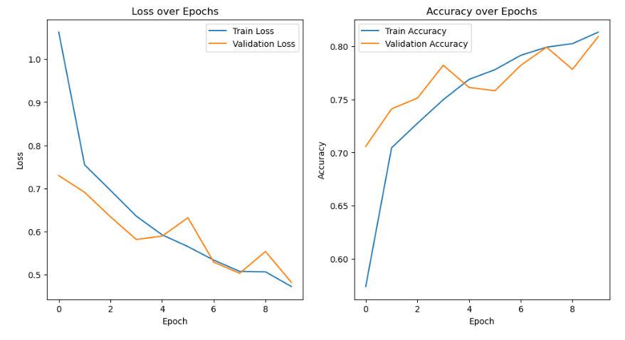
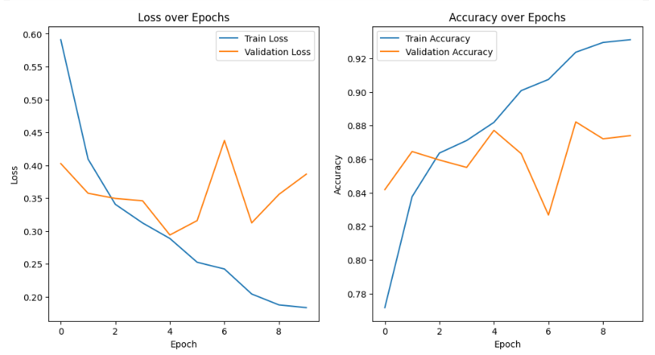
Results
SqueezeNet
EfficientNet_B0

Slide 11
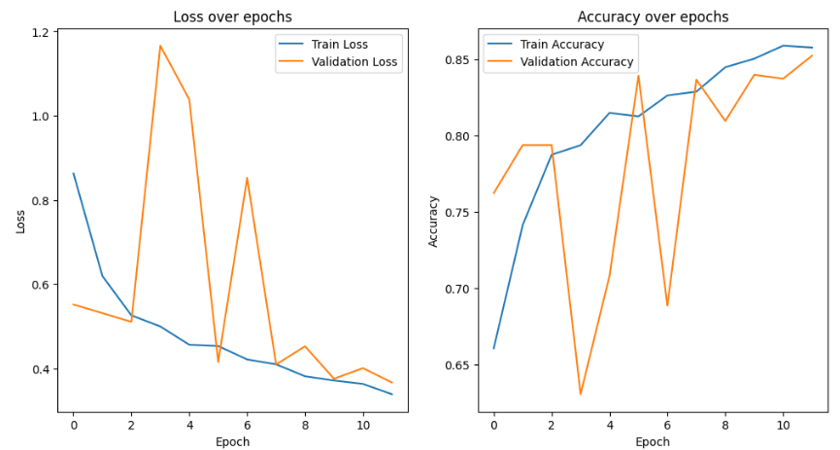
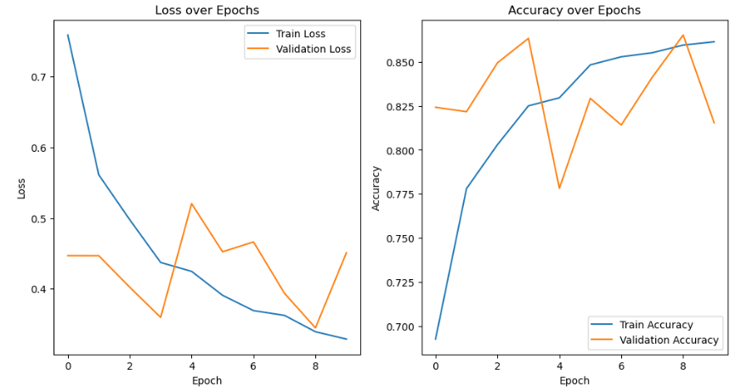
Results
Resnet-50
MobileNet_V2

Slide 12
Results
Model | F1-Score | Test Accuracy
ResNet50 | 0.8383 | 0.8434
MobileNet_V2 | 0.8279 | 0.8258
EfficientNet_B0 | 0.8558 | 0.8579
SqueezeNet | 0.8221 | 0.8226

Slide 13
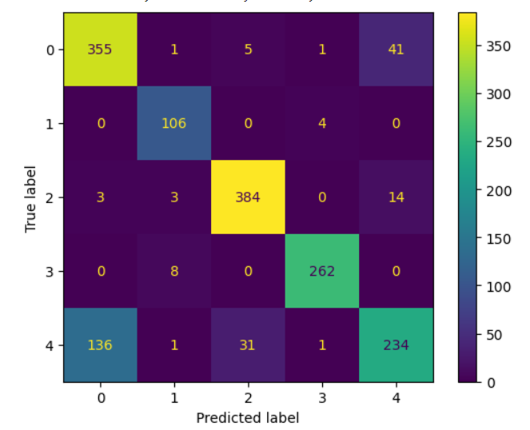
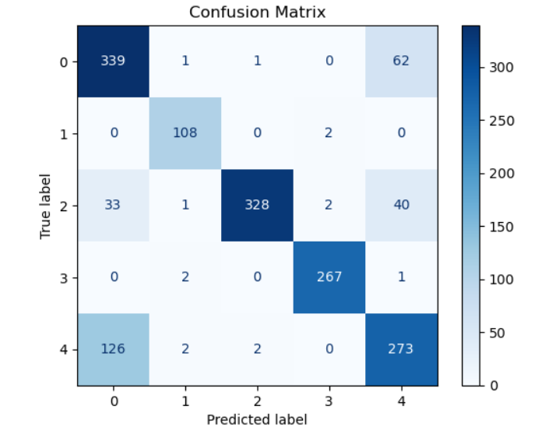
Performance evaluation
ResNet50
MobileNet_V2

Slide 14
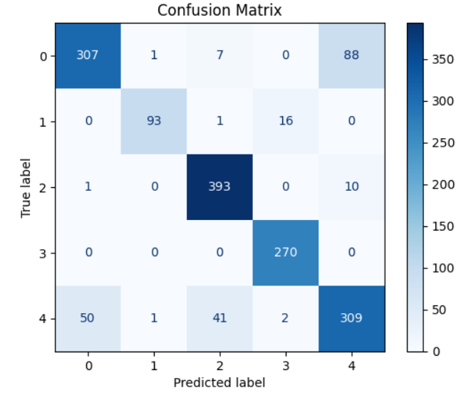
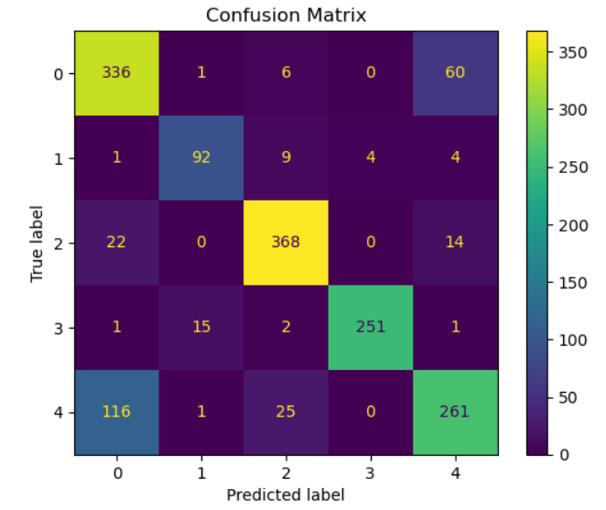
Performance evaluation
EfficientNet_B0
SqueezeNet
Notes:
confusion matrix, f1 score

Slide 15
Discussion
Model | Discussion
Resnet50 | Achieved the highest F1-score and test accuracy, suggesting that its deep architecture managed to capture complex features in lung X-ray images
MobileNet V2 | Showed respectable performance, but was slightly outperformed by ResNet50, likely due to its lighter architecture which might struggle with highly detailed features in medical images
EfficientNet-B0 | Displayed strong performance, closely competing with ResNet50, which suggests that its scaling approach effectively captures the necessary features in lung disease images, despite having a generally smaller and more efficient model structure.
SqueezeNet | While it did not match the performance of the more complex models, its efficiency in parameter usage is notable. This model might be more suitable for applications where model size and speed are more critical than achieving the highest possible accuracy.
Notes:
put the graphs, we can say the model

Slide 16
Work Division
Fatmeh Shaal | MHD Maen Khaskieh
Module Class | Dataset Class
Resnet50 | MobileNetV2
SqueezeNet | EfficientNet-B0
Both Team Members worked on the training Loop and Testing

Slide 17
Demonstration

Slide 18
References
Md. Zahangir Alom, Bishal Nag, Hasan Taha Islam, and Md. Zakir Hossain, "Explainable Lung Disease Classification from Chest X-Ray Images Utilizing Deep Learning and XAI," arXiv preprint arXiv:2404.11428, Apr. 2024. [Online]. Available: https://arxiv.org/abs/2404.11428
Sungyeup Kim, Beanbonyka Rim, Seongjun Choi, Ahyoung Lee, Sedong Min, and Min Hong, "Deep Learning in Multi-Class Lung Diseases’ Classification on Chest X-ray Images," Diagnostics, vol. 12, no. 4, p. 915, Apr. 2022. [Online]. Available: https://www.mdpi.com/2075-4418/12/4/915
J. Anitha, M. Kalaiarasu, N. Suresh Kumar, and G. Ram Sundar, "Detection and Classification of Lung Diseases Using Deep Learning," AIP Conf. Proc., vol. 2519, no. 1, p. 030001, Oct. 2022. [Online]. Available: https://doi.org/10.1063/5.0109980

